Slide 1
MINI-BATCH OPTIMIZATION
& DOCUMENT ANALYSIS
Ayodeji M. Lawal, Seoyeon Kang
Notes:
AYO: Good morning everyone, our project is on Mini-Batch Optimization and Document Analysis through Machine Learning Models. I am Ayodeji Lawal and my partner is Kate Kang.

Slide 2
BACKGROUND INFO
01
PROJECT OBJECTIVES
02
RESULTS
SOLUTION APPROACH
TABLE OF CONTENTS
04
03
DISCUSSION
05
CLOSING REMARKS
06
Document Analysis, Problem Statement
Model Type Evaluation, Hypothesis
Accuracy vs Computational Complexity
Describing Data,
Data Processing,
Existing Work,
Our Experiment
Limits of our Experiment,
Hypothesis Check
Future Research, References, Thank You
Notes:
AYO: We have a lot of ground to cover: background information, project objectives, solution approach, results, discussion and closing remarks. We’re gonna have to move fast.

Slide 3
01
Background Information
Document Analysis, Problem Statement
Notes:
AYO: First off background information.

Slide 4
Document Analysis
Documentary analysis (document analysis) is a type of qualitative research in which documents are reviewed by the analyst to assess an appraisal theme.
Wikipedia -
Notes:
AYO: At a general level, we are concerned with extracting some form of qualitative information from written communication using machine learning models.

Slide 5

PROBLEM STATEMENT
SARCASM DETECTION IN
NEWS HEADLINES
How can we detect emotional aspects, specifically sarcasm, across news headlines?
Notes:
AYO: More specifically, we are focused on capturing emotional undertones in text and at an exact level that emotion is sarcasm in news headlines.

Slide 6
02
Project Objectives
Model Evaluation, Hypothesis,
Notes:
KATE: So Ayo has mentioned the task. Now we consider our contribution to a more optimal solution.

Slide 7
MODEL EVALUATION
TRAINING & TESTING
ACCURACY
RUNTIME
MEMORY
Total execution time when model is trained or makes predictions. Measured with Memory Profiler.
Percent of accurate predictions measured by SKLearn
Maximum amount of memory used when model is trained and maks predictions. Measured with Memory Profiler.
Notes:
KATE: By our definition, optimal has more requirements than just accuracy these being runtime and memory use.
We believe effective models need to classify accurately and be resource efficient while they train and predict.

Slide 8
HYPOTHESIS
ACCURACY
Smaller Size
=
Higher Accuracy
MINIBATCH HYPER PARAMETER
How will variations to this parameter affect the performance of our models?
RUNTIME
MEMORY USE
Smaller Size
=
Longer Runtime
Small Size
=
Less Memory Use
Notes:
KATE: We’ve chosen to focus on the mini-batch hyper parameter. Our hypothesis is that as we decrease minimatch size we will see some interesting changes in performance.

Slide 9
03
SOLUTION APPROACH
Describing Data, Existing Work, Our Experiment
Notes:
AYO: Armed with a task and an objective, we begin to take inventory of our resources and construct our experiment.

Slide 10


DESCRIBING DATA
LABELS: “is_sarcastic”
FEATURES: “headline
1 - Sarcastic Headlines
Source: The Onion
0 - Acclaim Headlines
Source: Huffington Post
Headlines as the appear on the websites.
Notes:
AYO: Through a competition on Kaggle, we found a dataset consisting of headlines from a sarcastic news source called the onion and an acclaimed news source called the huffington post.

Slide 11
DATA PROCESSING
STEP: 1
STEP: 2
STEP: 3
STEP: 4
Data Clearing
Stop Word Removal
Stemming and Lemmatization
Tokenization & Word2Vec
Notes:
AYO: Even better, a simple four step process for transforming the data from words to numerical vectors computers can understand and models can interpret was readily available to us to use.

Slide 12
EXISTING WORKS
 | CNN | RNN | RANDOM FOREST | SVM
ACCURACY | 0.73 | 0.80 | 0.66 | 0.54
RUNTIME | ??? | ??? | ??? | ???
MEMORY USE | ??? | ??? | ??? | ???
Notes:
KATE: Finally, we were able to find and run four preconstructed models and assess their given accuracy. From here it would be our job to measure runtime and memory use in a normalized state, pick the top two, which were two neural networks, CNN and RNN and move forward with our experiment.

Slide 13
OUR EXPERIMENT
~ NEURAL NETS ONLY ~
Default Batch Size
100
50
200
75
25
Largest Batch Size
Smallest Batch Size
Notes:
KATE: In addition, we would have to develop an algorithm that iterates through five different batch size settings and record our performance metrics while the models train and predict.

Slide 14
04
RESULTS
Accuracy, Runtime, & Memory use
Notes:
AYO: So you’re all probably wondering? What did we find?

Slide 15
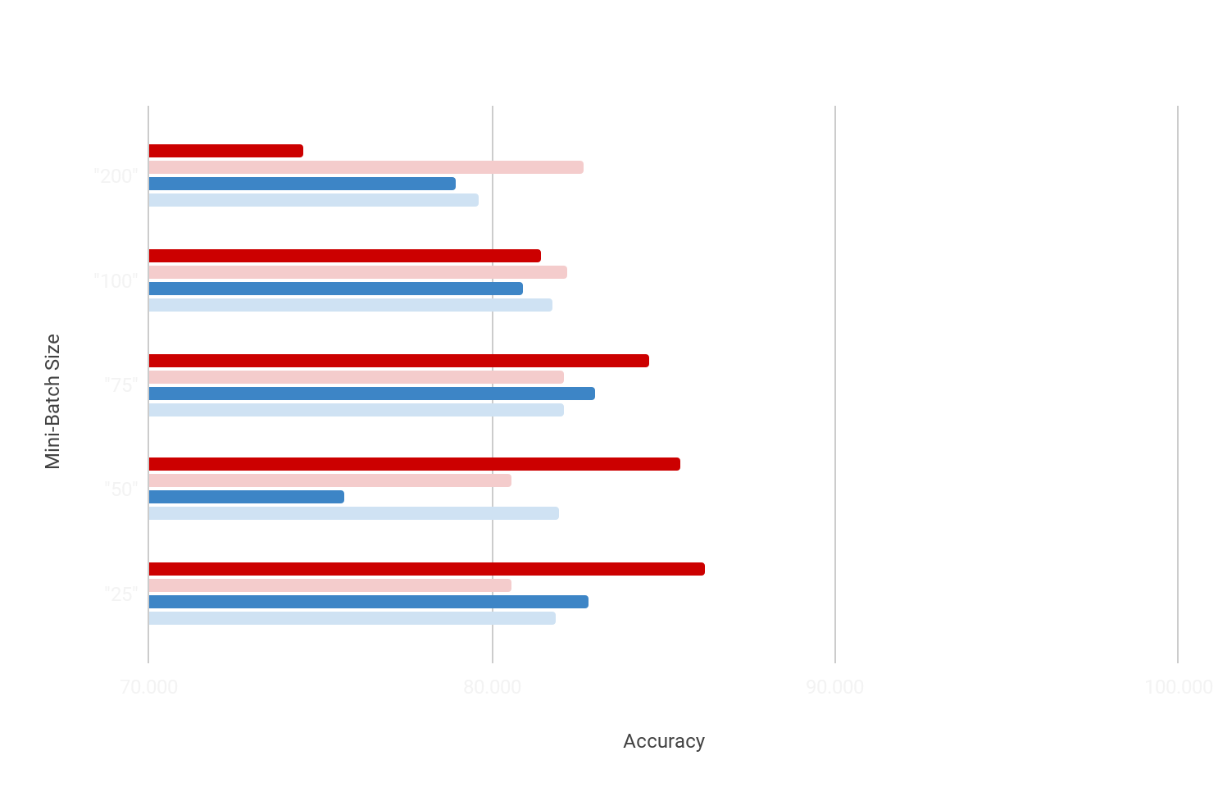
MODEL ACCURACY
CNN - Train
CNN - Pred
RNN - Train
RNN - Pred
TRENDS
Prediction Accuracy is higher than Training Accuracy with Large Batches
Prediction Accuracy potentially decreases with size.
CNN outperformed RNN in Predicting
NOTE: Graph Starts at 70% and goes to 100%
NOTE: Abnormality in minibatch size 50, discussed in paper.
Notes:
AYO: Our keystone discovery was that prediction accuracy can exceed training accuracy in models trained with large mini batches. Furthermore, in the case of the CNN prediction accuracy decreases as size decreases; while the RNN increases up to a bound as size decreases.

Slide 16
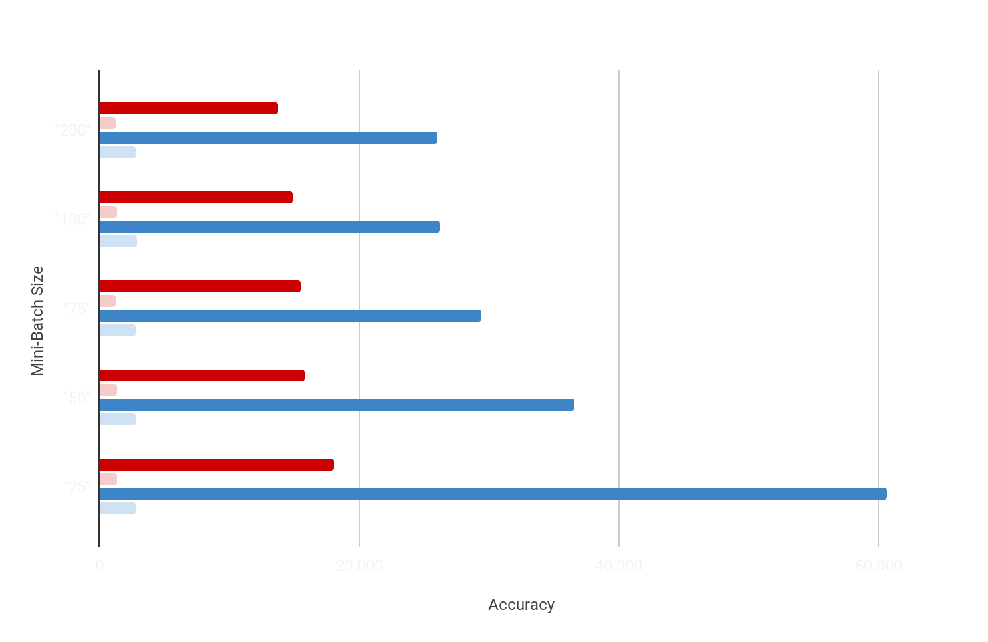
MODEL RUNTIME
CNN - Train
CNN - Pred
RNN - Train
RNN - Pred
TRENDS
Training Runtime Decreases as Size Increases
Prediction Times are Unaffected
CNN Runs Faster
NOTE: Graph Starts at 0s and goes to 60s
Notes:
KATE: Our second discovery was that training time decreases as batch size increases. In tandem with our first result, this means we can train models with equal accuracy in shorter time spans.

Slide 17
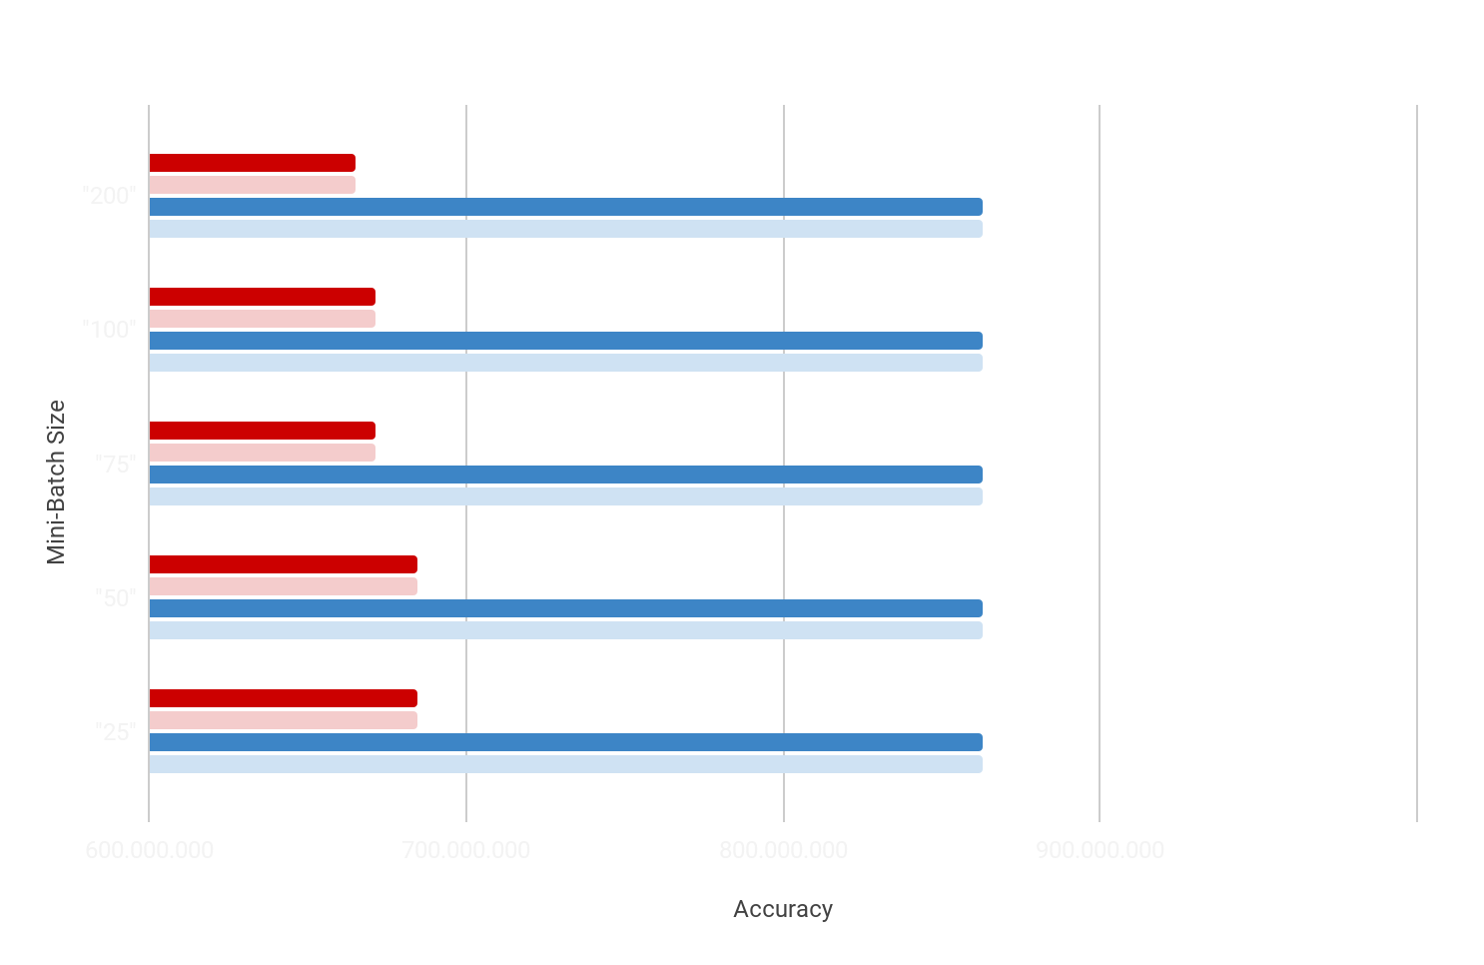
MODEL MEMORY USE
CNN - Train
CNN - Pred
RNN - Train
RNN - Pred
TRENDS
Memory Use is Statistically Unaffected By Size Variation
CNN outperformed RNN
NOTE: Graph Starts at 600 MiB and goes to 1,000 MiB
Notes:
KATE: Our third discovery is that memory is slightly affected to unaffected by minibatch size variations. In the case of CNN’s we can actually decrease memory use by 25%.

Slide 18
05
DISCUSSION
Limit of our Experiment, Hypothesis Check
Notes:
AYO: Now, what can we conclude from our results?

Slide 19
HYPOTHESIS CHECK
ACCURACY
Smaller Size
=
Higher Accuracy
MINIBATCH HYPER PARAMETER
How will variations to this parameter affect the performance of our models?
RUNTIME
MEMORY USE
Smaller Size
=
Longer Runtime
Small Size
=
Less Memory Use
Notes:
AYO: So coming back to our hypothesis we see that we were correct about effects on runtimes, incorrect about effects on memory use, and semi correct about effects on accuracy as it varied between data and models. In addition, our research hints at some sort of “mini-batch trick”, where larger match sizes that perform poorly in training perform well in prediction.

Slide 20
LIMITS OF EXPERIMENT
SMALL SAMPLE SIZE
INEFFICIENT ALGORITHM
ONE HYPER PARAMETER
HARDWARE VARIATIONS
BIT TYPE
STORAGE
OPERATING SYSTEM VARIANCE
Only sampled five possible sizes out of an infinite amount.
Algorithm can does not collect data all at once.
Does not account for how hyperparameters interact.
Not all models are run on high performance cloud computers.
Performance varies from 32 bit to 64 bit storage.
Windows, MacOS, Linux, Android, iOS, etc.
Notes:
AYO: Computational complexity is a very broad subject and there is definitely more to be explored. It is also a nuranced subject and minor variations in testing conditions could yield different results.

Slide 21
06
CLOSING REMARKS
Future Research, References, Thank You
Notes:
KATE: And now closing.

Slide 22
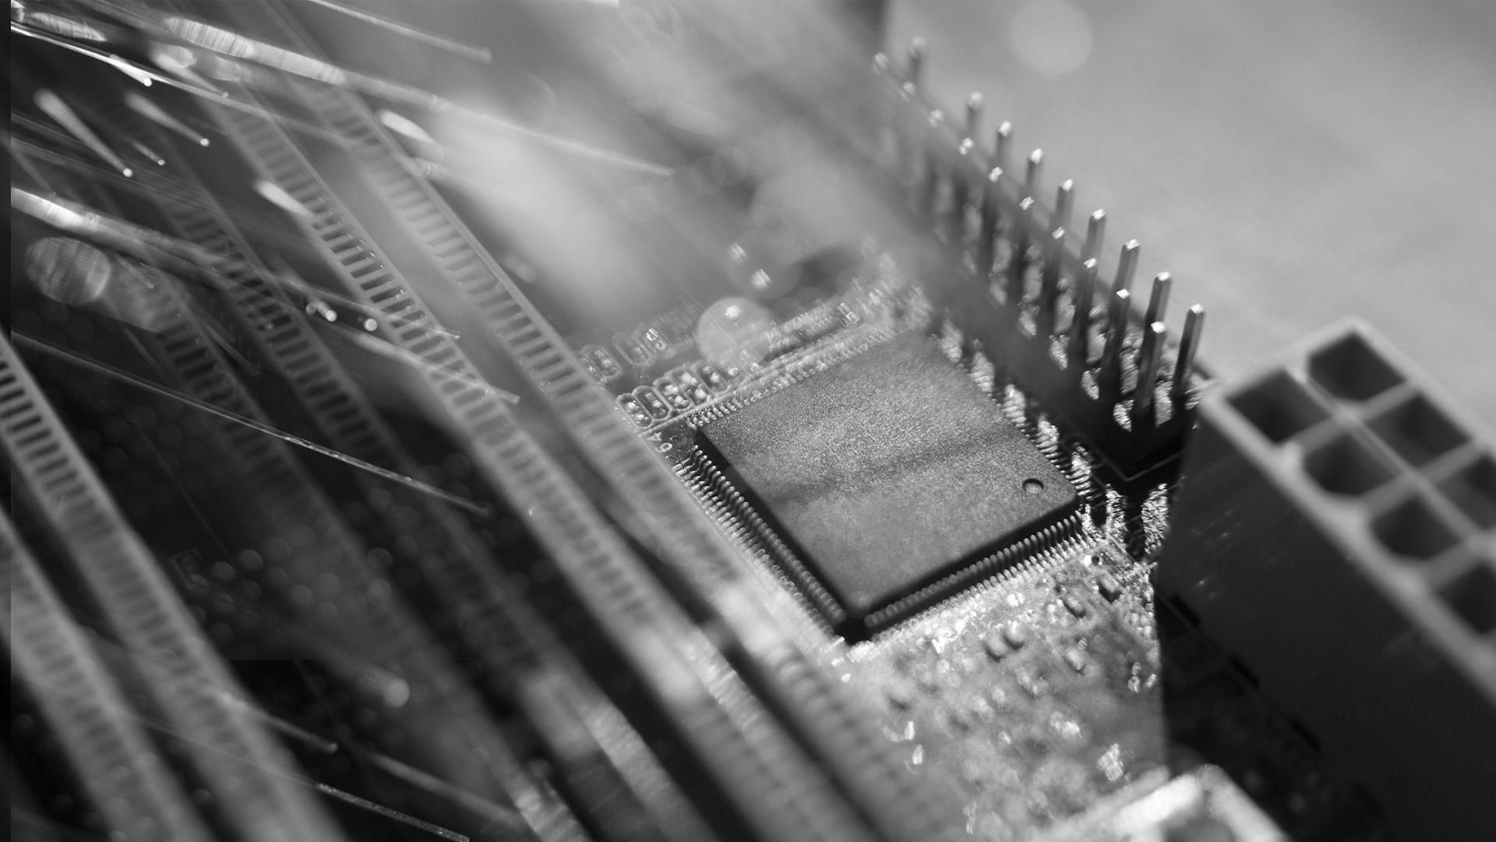

FUTURE RESEARCH
Notes:
Further researches can be done to find out if the machine can learn and detect any other kind of emotions behind humans’ text rather than just sarcasm. Also, this sarcasm research can be implemented on other texts to test if the model can detect sarcasm from any other texts rather than just news headlines.

Slide 23
REFERENCES
296 Responses to Save and Load Machine Learning Models in Python with scikit-learn
Stanford - Stemming and lemmatization
A Beginner's Guide to Word2Vec and Neural Word Embeddings
User CPU time vs System CPU time?
How to store the result from %%timeit cell magic?
What does '%% time' mean in python-3?
ipython - What is %timeit in python?
Notes:
These were our references

Slide 24
THANKS
Does anyone have any questions?
Notes:
Thank you for listening. Does anyone have any questions?

Slide 25
CNN - Train
CNN - Pred
RNN - Train
RNN - Pred
Notes:
AYO: Our keystone discovery was that prediction accuracy can exceed training accuracy in models trained with large mini batches. Furthermore, in the case of the CNN prediction accuracy decreases as size decreases; while the RNN increases up to a bound as size decreases.

